Slide 1


Slide 2


Slide 3





Overview Events, Outreach, Progress
I. Stich
Inst. of Physics, Slovak Academy of Sciences
http://www.fu.sav.sk
Wed, Mar 02, 2022

Slide 4
Overview Events, Outreach, Progress
(WP6)
I. Stich
Inst. of Physics, Slovak Academy of Sciences
http://www.fu.sav.sk
Wed, Mar 02, 2022

Slide 5

Outline
training-education events: past
training-education events in 2022
training-education events: future

Slide 6
Training overview
training-education events: past
training-education events in 2022
training-education events: future
under debate
with WP7
⇐ moved to WP4

Slide 7
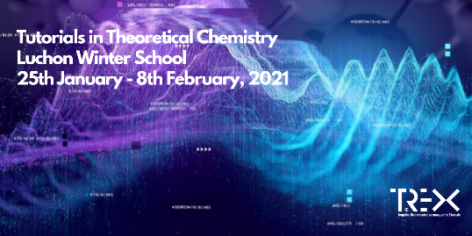
Training 2021
training-education events: past
Luchon Winter school '21 (Anthony, Claudia)
(virtual)
training-education events in 2022
training-education events: future

Slide 8
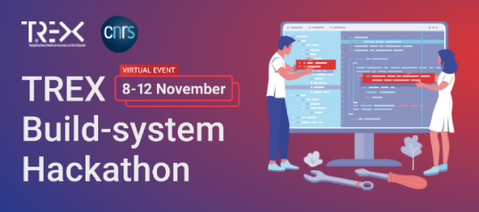
Training 2021
training-education events: past
TREX Build-systems Hackathon (Anthony)
(virtual)
training-education events in 2022
training-education events: future

Slide 9
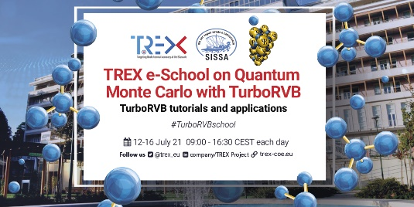
Training 2022
additional event:
training-education events: past
TREX e-school on Quantum Monte Carlo with TurboRVB (Sandro, Michele, Kosuke)
(virtual)
training-education events in 2022
training-education events: future
additional events

Slide 10

Training 2022
training-education events: past
Luchon Vinter School #2 (Anthony)
(virtual)
training-education events in 2022
training-education events: future
additional events

Slide 11
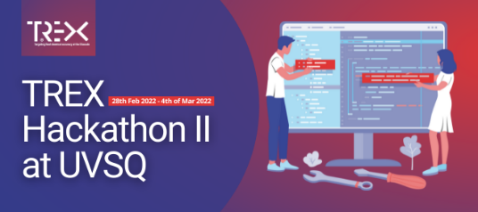
Training 2022
training-education events: past
TREX Hackaton II (Wiliam)
(internal, in presence)
training-education events in 2022
training-education events: future
additional events

Slide 12

Training 2022
training-education events: past
TREX Hackaton III (Fabio, Wiliam)
CINECA GPU Hackathon 2022
(in presence)
training-education events in 2022
Digital Event
June 13, 20-22, 2022
training-education events: future
additional events

Slide 13

Training 2022
training-education events: past
QMC Hands-on Summer Workshop (Ivan,
Julie,...)
(in presence)
training-education events in 2022
training-education events: future
additional events

Slide 14
Training 2022
training-education events: past
TREX e-school on Quantum Monte Carlo with TurboRVB #2 (Sandro, Michele, Kosuke)
(in presence in Trieste)
training-education events in 2022
training-education events: future
additional events

Slide 15
Training 2022
training-education events: past
CESTC 2022 QMC satellite (Claudia, Anthony,
Ivan)
(in presence)
training-education events in 2022
???
training-education events: future
???
additional events

Slide 16
Training 2022
training-education events: past
Workshop on TREX platform & ML (Kasia...)
(in presence at TUL)
training-education events in 2022
training-education events: future
additional events

Slide 17
Training 2022
training-education events: past
School: TREX SW & ML &AiiDA (Claudia...)
(in presence ICTP or CECAM)
training-education events in 2022
training-education events: future
additional events

Slide 18
Training 2023
training-education events: past
Luchon Winter school '21 (Anthony, Claudia)
final (virtual)
training-education events in 2022
training-education events: future
additional events

Slide 19
Training 2023
training-education events: past
Code Developer Workshop (Ivan,...)
(in presence in Bratislava, Slovakia)
training-education events in 2022
??? Accompany with internal TREX meeting???
training-education events: future
additional events

Slide 20
Training 2023
training-education events: past
Hackaton # IV ...Final code optimization (???)
(in presence in ???)
training-education events in 2022
training-education events: future
additional events

