Slide 1
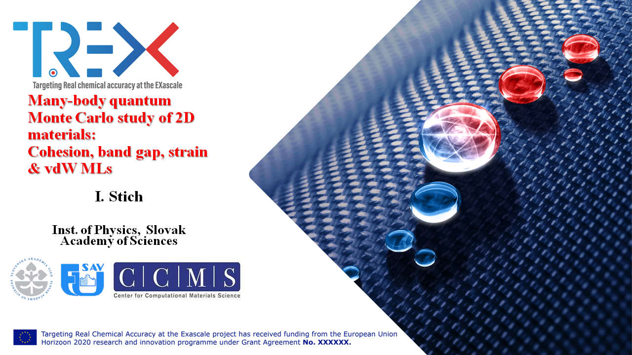

Slide 2





Phosphorene and 2D materials
J. Brndiar, Y. Huang, A. Faizan, Marko Milivojevic,
I. Štich
CCMS, Inst. of Physics, Slovak Academy of Sciences
SLOVAK ACADEMY OF SCIENCES
http://www.fu.sav.sk
Funding:

Slide 3
Phosphorene and 2D materials
J. Brndiar¹, Y. Huang¹, A. Faizan¹, Marko Milivojevic,
T. Frank², R. Derian¹, K. Tokár¹, L. Mitas³, J. Fabian², I. Štich¹
¹ CCMS, Inst. of Physics, Slovak Academy of Sciences, Bratislava, Slovakia
² University of Regensburg, Inst. for Theoretical Physics, Germany
³ Dept. of Physics, North Carolina State University, Raleigh, U.S.A.
http://www.fu.sav.sk
Funding:

Slide 4
Outline:
Intro. 2D materials and phosphorene
Calculations: 1) completed, phosphorene
- band gap
- cohesion
2) in progress, phosphorene
- strain effects
3) in preparation, MoS₂
- strain effects
- vdW multilayers
Summary

Slide 5
2D materials
a number of 2D materials prepared by:
- exfoliation (gr, phosphorene, TM -dichalcogenides)
- epitaxial growth (silicene, germanene…)
electronic properties:
metals ⇔ semimetal ⇔ semiconductor ⇔ wide gap insulator
Pd, Rh
graphene
TMD
h-BN
high-mobility high-speed and fast switching semiconductor devices requiring low D-materials
high carrier mobility
direct band gap (often)

Slide 6
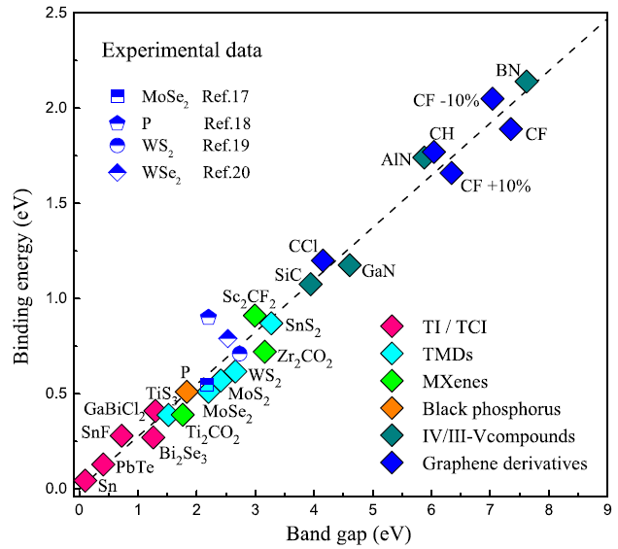
2D materials
exciton
gap states
2D materials: bandgaps
trion
fundamental (quasiparticle) gap:
exciton
Δ_{f}
DFT, GW
difficult
excitonic binding energy:
Δ_{e}
BSE…GW-BSE
fundamental (quasiparticle) gap
optical gap:
easy
optical gap
Δ_{o} = Δ_{f} - ⏐Δ_{e} ⏐
universal scaling relation (in 2D) for Δ_{e}:
Δ_{e} = Δ_{f} / 4
Z. Jiang, Z. Liu, Y. Li, and W. Duan, Phys. Rev. Lett. 118, 266401 (2017)

Slide 7
2D material phosphorene
What did we learn from 2D phosphorene???
Calculations: 1) previous, phosphorene
- band gap
- cohesion

Slide 8
2D material phosphorene
band gaps:

Slide 9
2D material phosphorene
band gaps:

Slide 10
2D material phosphorene
band gaps:
!!!Δ_{o} reflects genuine exp. spread!!!
⇒ typical also for other 2D materials
need for much more accurate methods than
DFT, GW, GW-BSE !!!
QMC

Slide 11
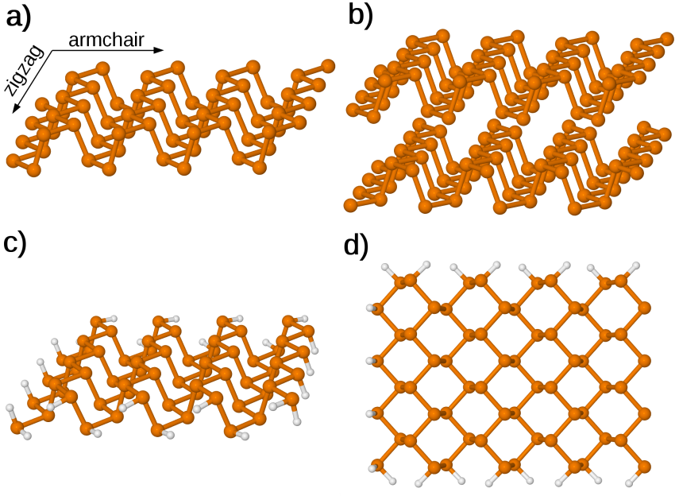
QMC: calculations
3 complete QMC calculations (including finite-size scaling):
periodic setup: 1×1 … 6×6 i.e. 20…720 explicitly corr. electrons
- B3LYP nodal hypersurfaces
- PBE nodal hypersurfaces
T. Frank, R. Derian, K. Tokár, L. Mitas, J. Fabian, and I. Štich, Phys. Rev. X 9, 011018 (2019).

Slide 12
QMC: calculations
3 complete QMC calculations (including finite-size scaling):
periodic setup: 1×1 … 6×6 i.e. 20…720 explicitly corr. electrons
- B3LYP nodal hypersurfaces
- PBE nodal hypersurfaces
strict upper bound
cluster setup: 4×4, 5×5, 6×6
- B3LYP nodal hypersurfaces
T. Frank, R. Derian, K. Tokár, L. Mitas, J. Fabian, and I. Štich, Phys. Rev. X 9, 011018 (2019).

Slide 13
QMC electronic band gap
thermodynamic limit
extrapolation to N → ∞ :
linear in 1/N
(N = 4 × L × L)
T. Frank, R. Derian, K. Tokár, L. Mitas, J. Fabian, and I. Štich, Phys. Rev. X 9, 011018 (2019).

Slide 14
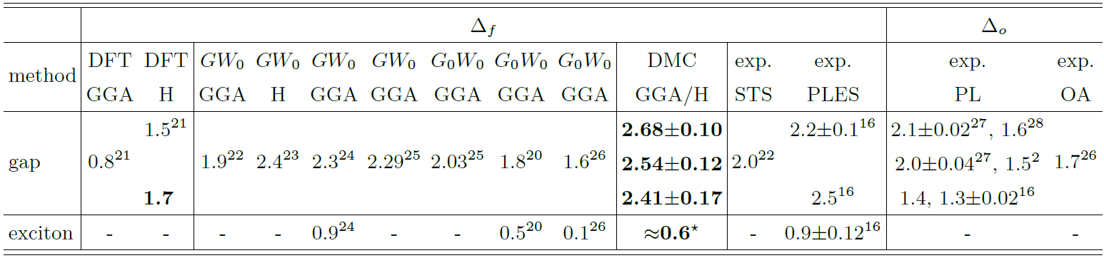
QMC electronic band gap
DFT
GW
DMC
exp.
B3LYP/DMC, PBC
PBE/DMC, PBC
B3LYP/DMC, clust.
≈1eV
≈1eV
≈0.2 eV
≈1eV
DMC: Δ_{f} ≈ 2.4 eV
GW: underestimates Δ_{f}
Δ_{f} ≈ 2.4 eV
Δ_{o} ≈ 1.8 eV
Δ_{e} ≈ 0.65 eV
Δ_{e} ≈ 0.6 eV
T. Frank, R. Derian, K. Tokár, L. Mitas, J. Fabian, and I. Štich, Phys. Rev. X 9, 011018 (2019).
L. Li, J. Kim, C. Jin, et al. Nat. Nanotechnol. 12, 21 (2016).

Slide 15
QMC electronic band gap
DFT
GW
DMC
exp.
≈1eV
≈1eV
≈0.2 eV
≈1eV
DMC: Δ_{f} ≈ 2.4 eV
Δ_{f} ≈ 2.3-2.4 eV
Δ_{o} ≈ 1.8 eV
Δ_{e} ≈ 0.6 eV
T. Frank, R. Derian, K. Tokár, L. Mitas, J. Fabian, and I. Štich, Phys. Rev. X 9, 011018 (2019).
X.Wang, A. M. Jones, K. L. Seyler, et al.,Nat. Nanotechnol. 10, 517 (2015).

Slide 16
QMC cohesion
- 3D crystal: 3:43 eV/atom (expt.)
- interlayer binding: 816 meV/atom (QMC calc.)
thermodynamic path:
P₄ molecule→ bulk black phosphorus→ phosphorene
fixed node error correction:
P atom and P₄ molecule
(CCSD(T) in CBS limit):
0.09 eV/atom B3LYP/DMC
0.09 eV/atom PBE/DMC
⇒3.284(6) eV/atom B3LYP/DMC
⇒3.268(4) eV/atom PBE/DMC
⇒ ground-state essentially exact
T. Frank, R. Derian, K. Tokár, L. Mitas, J. Fabian, and I. Štich, Phys. Rev. X 9, 011018 (2019).
Ch. Kittel, Introduction to Solid State Physics, 8th ed. (John Wiley & Sons, Inc., NJ, 2005) p. 50.
L. Shulenburger, A. D. Baczewski, Z. Zhu, J. Guan, and D. Tománek, Nano Lett. 15, 8170 (2015).

Slide 17
2D materials tuning
c
2D materials can be tuned by:
- # of layers
- # applied strain:
MoS₂: strainability: >10%, gap: <0,1.8> eV
- dielectric environments:
substrates
capping

Slide 18
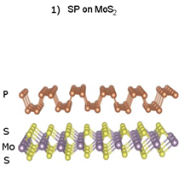
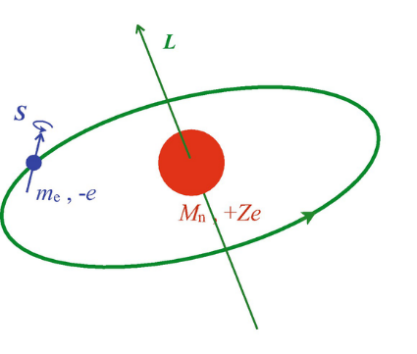
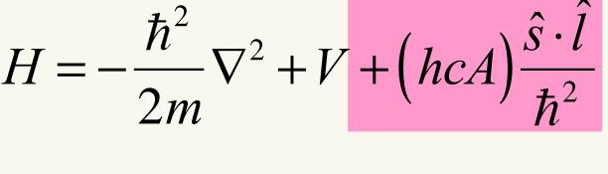
2D materials tuning
2D materials can be tuned by:
- proximity effects
semiconductor +
carrier mob.
strong spin effects ⇒
manipulation of spin prop. via orbital prop.
⇓
- manipulate directly
spin-orbit coupling

Slide 19
2D materials strain
Calculations: 2) in progress, phosphorene
- strain effects

Slide 20
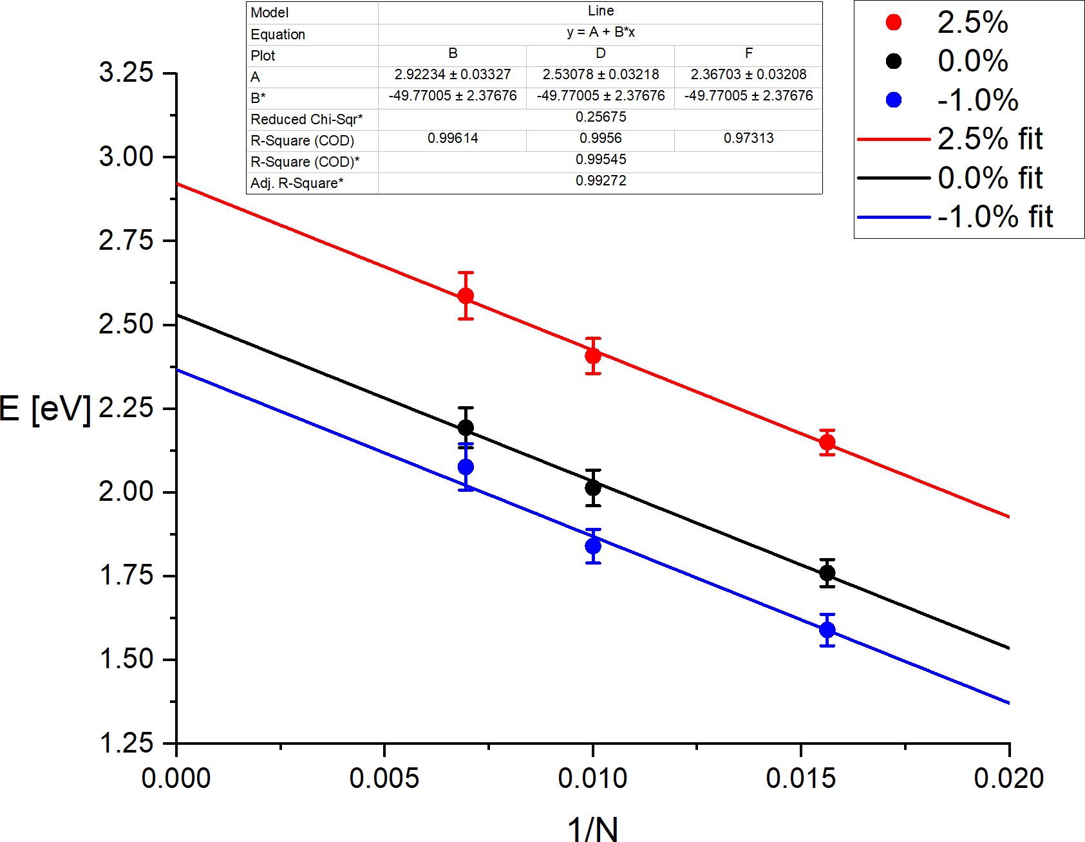
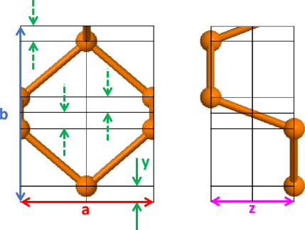
Strain in 2D phosphorene
quasiparticle band gap scales linearly with the applied strain (see dashed lines which highlight the gap ratios for -1.00%: 0%: 2.5% ).
highly nontrivial as the band gaps are differences between ground- and excited-state PESs.
The strain band gap tuning is quite strong; the QMC values are about factor 2 stronger than those resulting from DFT (PBE, B3LYP) treatment, not shown.
6×6
5×5
E_{g} [eV]
4×4
!!!However, we don‘t know the unstrained structure!!!
more serious
(lattice parameters a and b taken from 3D black phosphorus crystal)
...and internal parameters y and z only DFT optimized
less serious
4 structural parameters
J. Brndiar, L. Mitas, J. Fabian, and I. Štich, in preparation (2021)

Slide 21
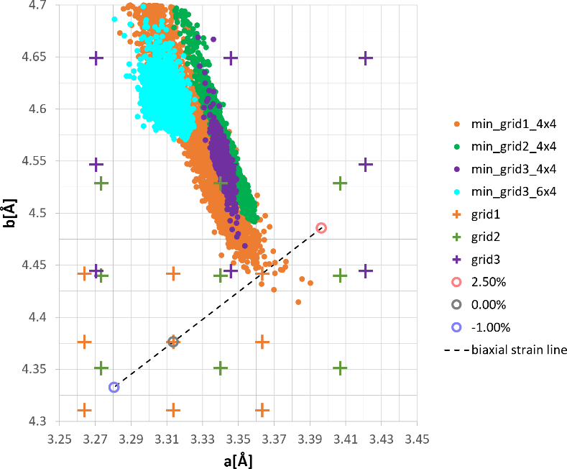
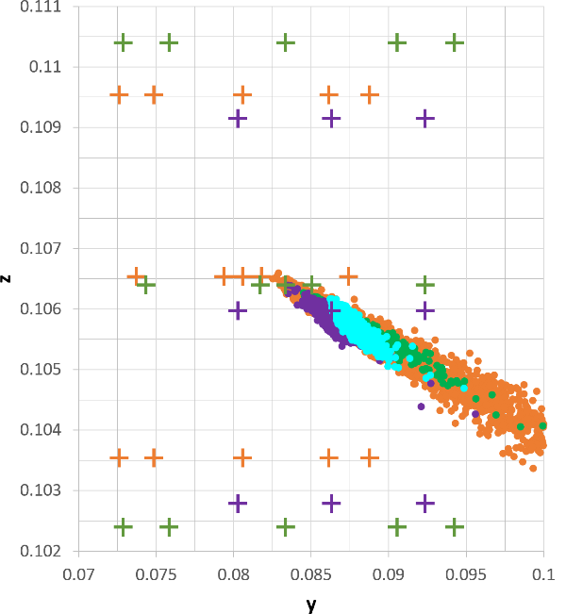
Strain in 2D phosphorene
Full approach:
fixing all 4 parameters a, b, y, and z: paraboloid approximation
to fit the 4 structural parameters, a
grid of 25 points around the
presumed minimum was selected
total ground-state energies calculated
4D paraboloids were fitted taking
into account the QMC error bars.
3D crystal
⇓
⇑
previous results
⇒ large modification of the b lattice parameter
⇒ more modest modification of the other 3 parameters
this allows calculation of the effect of arbitrary strains:
- uniaxial
- biaxial
fitted analytical formula for
ground- and excited states
J. Brndiar, L. Mitas, J. Fabian, and I. Štich, in preparation (2021)
…

Slide 22
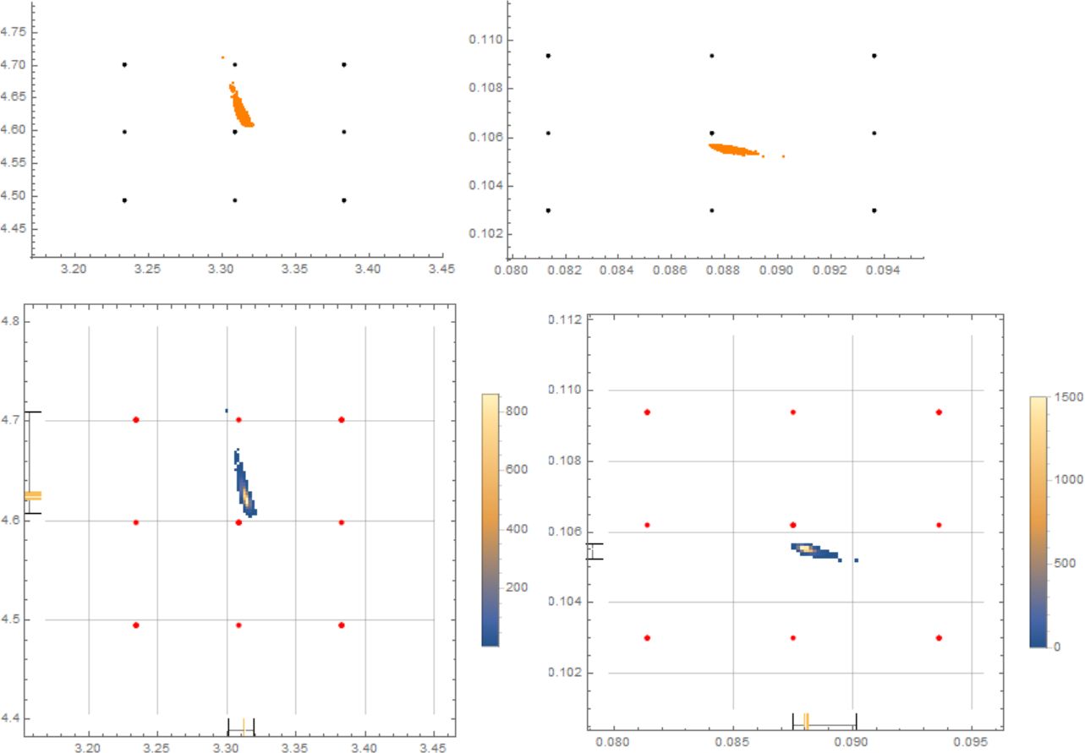
2D material MoS₂
b [Å]
z [Å]
a [Å]
y [Å]
8x4

Slide 23
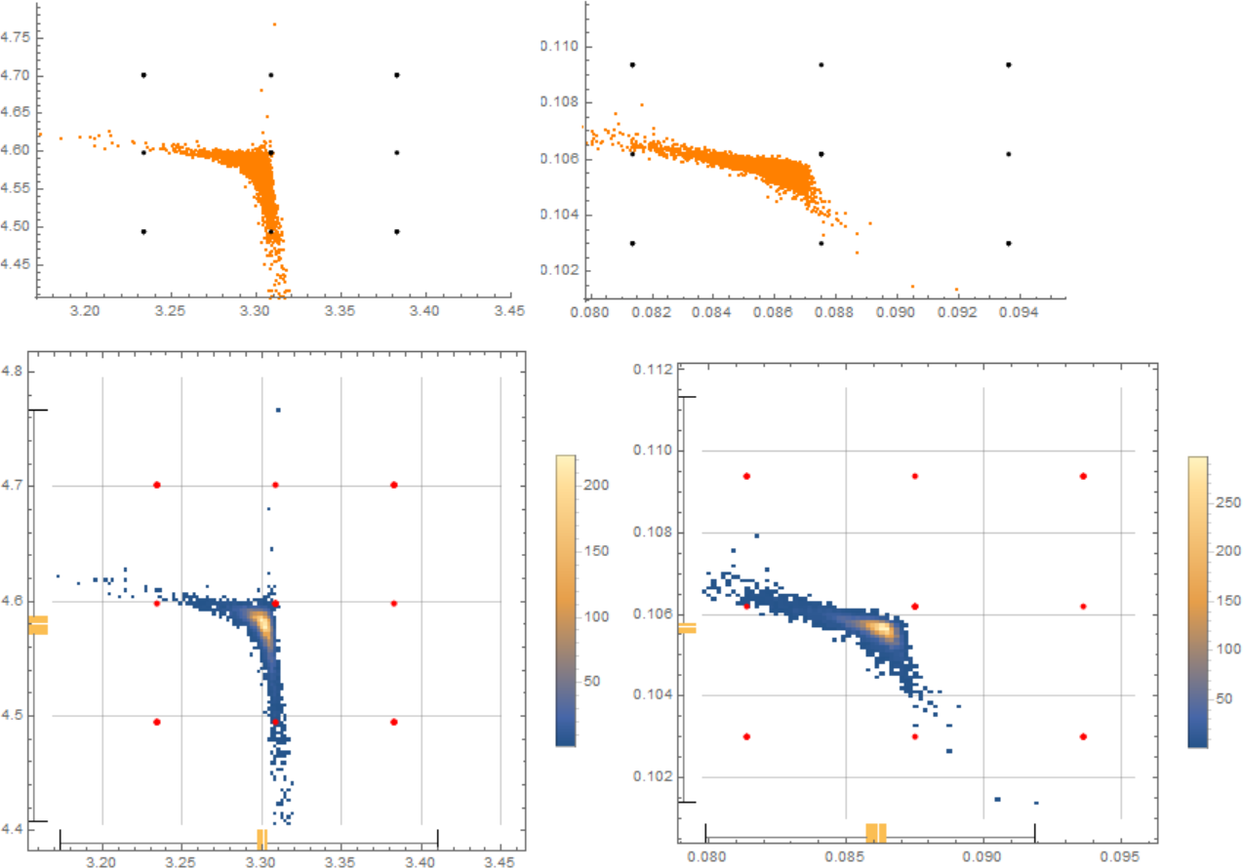
2D material MoS₂
b [Å]
z [Å]
a [Å]
y [Å]
8+8: twist average

Slide 24
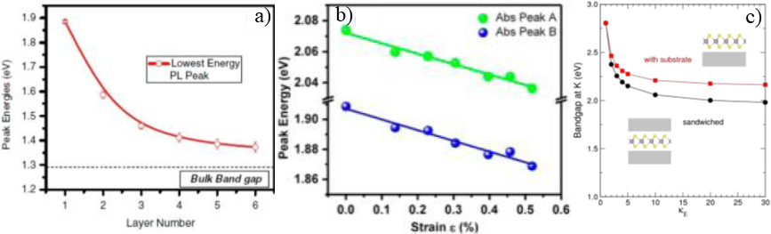
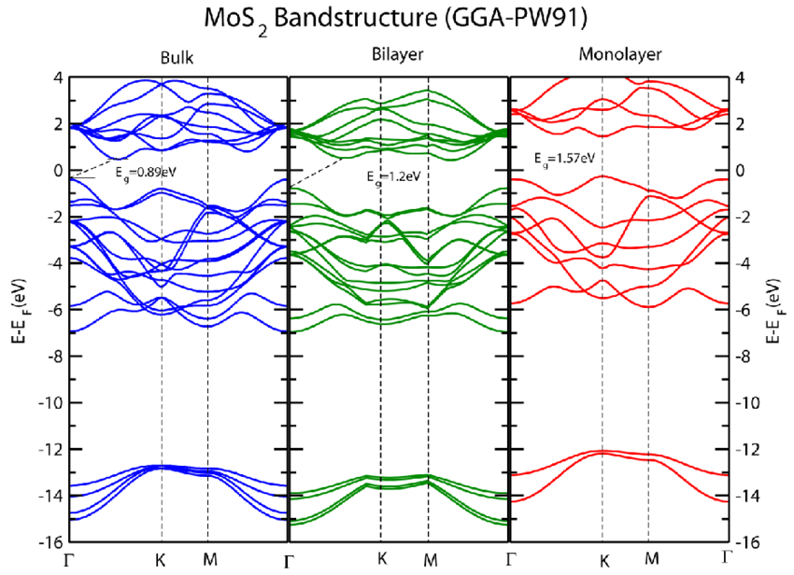
2D material MoS₂
tuning structural & electronic properties of MoS₂:
# layers
⇓
strain
⇓
dielectric embedding
⇓
complication (with respect to phosphorene):
- 1-layer direct K→K′ band gap
- 2-layer indirect Γ→K/2 band gap
R. Ganatra and Q. Zhang, ACS Nano 8, 4074 (2014).

Slide 25
2D material MoS₂
3) in preparation, MoS₂
- strain effects
- vdW multilayers

Slide 26
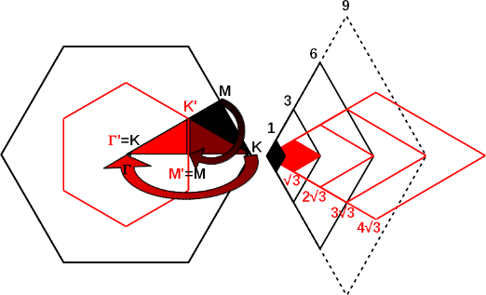
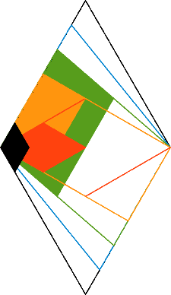
2D materials MoS₂
tuning structural & electronic properties of MoS₂:
- 1-layer direct K→K′ band gap
cell | 3×3 | 4×4 (c) | 5×5 (c) | 6×6 | 2√3×2√3 | 3√3×3√3 | 4√3×4√3
# electrons | 234 | 416 | 650 | 936 | 312 | 702 | 1248
- 2-layer indirect Γ→K/2 band gap
cell | red | orange | green | blue | black
# electrons | 624 | 936 | 1248 | 1560 | 1872

Slide 27
...last but not least...
CPU/GPU hours:
1) Mare Nostrum: PRACE Tier 0
2) Snellius (NL): PRACE Tier 1
3) Summit (ORNL): director award
4) ??? Marconi (IT): PRACE Tier 0??? (with Sandro & Michele)

Slide 28
Summary
1) previous, phosphorene
important material characteristics in single layer phosphorene calculated/estimated by QMC:
- fundamental gap Δ_{f}
- optical gap Δ_{o}
- exciton binding energy Δ_{e}
- cohesion
effects of strain calculated in single layer phosphorene
- strain effect appears to be massive and quantitatively different from DFT
- fixed-node DMC equilibrium structure found
- b lattice parameter significantly different from the crystal
- calculations will allow to determine the effect of arbitrary strain on the gap
2) in progress, phosphorene
outlooks towards QMC calculation of lazer & train effects in MoS₂
3) in preparation, MoS₂

