Slide 1
DESIGNING A HIGH PERFORMANCE AND PORTABLE LIBRARY (QMCKL): ONE OF THE MAJOR CHALLENGES ADDRESSED BY TREX CoE
A. Scemama, V.G. Chilkuri (Univ Toulouse), P. De Oliveira, C. Valensi, W. Jalby (UVSQ)

Slide 2
TREX Mission: To develop, promote, and maintain open-source, exascale-ready software solutions in (stochastic) quantum chemistry Materials modeling at the nanoscale with extreme accuracy
TREX in a nutshell
Scientists in quantum chemistry, physics, and machine learning
Software and HPC experts
Tech and communication SMEs
Representative of user communities

Slide 3
TREX: Targeting REal chemical accuracy at the EXascale
Objective: Make codes ready for exascale
What: Use Quantum Monte Carlo Methods
Highly accurate
Massively parallelizable (multiple QMC trajectories)
No Blocking communications
CPU intensive (difficult to exploit)
How: Instead of re-writing codes, provide libraries
A library for exchanging information between codes:
TREXIO Enables HTC
A library for high-performance numerical computation:
QMCkl Enables HPC
Create a platform of interoperable flagship codes extendable and/or operable with codes outside TREX

Slide 4
Objectives
QMCKL Objectives/constraints
PRODUCTIVITY: Used and developed by scientists, can be called from different languages
PORTABILITY: available on large number of hardware and software platforms
PERFORMANCE: Must be efficient
“Classical” challenge : be good simultaneously on the 3 objectives. There is a workshop at SC devoted to this triple objective.
We need to go beyond these classical objectives:
Not only performance but also energy consumption should be a major goal
Numerical accuracy is extremely important

Slide 5
Major axes/guidelines
Major Axes in QMCKL development
Focus and Specialization: focused on well identified objectives (not general)
Ease of interaction with software and hardware environment: beyond classic portability
Use of Advanced Tuning Tools: adaptable library via tools instead of static library

Slide 6
Objectives
Focus and Specialization
Application target = QMC: use of high degree of parallelism present in most QMC applications. Focus on single node/core implementations
Focus on a few reference platforms: CPU (ISA: X86 + ARM Neoverse), GPU
Specific needs of our target applications: for example no need of general arbitrary size Matrix Multiplies. Many of our apps are using Rank K Updates: (MxK) x (KxM) with K much smaller than M
GOOD NEWS:
For our propose (scientific computing) X86 and ARM general architecture share a lot of common characteristics with secondary differences which can be dealt with automatically
CPU and GPU all strongly require vectors…. But memory constraints are very different

Slide 7
Objectives
Ease of Interaction with hardware and software
Interaction with context: routines available in source form so compiler can inline and optimize through calls
Develop optimized but generic code versions: use tools for generating highly optimized and specific version
Strongly structure arrays within the library: systematic use of tiled arrays for improving memory hierarchy usage
Systematic use of (1+n) library versions: a pedagogical/reference version and several optimized versions
OPEN SOURCE + STANDARDS: easy to modify and integrate. Strong use of standard: OpenMP directives for GPU and vectorization

Slide 8
Objectives
Use of Advanced Tuning tools
Use of automatic generation tools: from a high level generic ASM generate X86 and ARM versions. This will allow to directly embed low level code (“ASM volatile”).
Use of autotuning tools: very useful for last mile optimization, explore automatically different code variants and parameters.
Use of advanced performance analysis tools: monitor not only vectorization ration (% of vector instructions) but also vectorization efficiency (vector width used).
Use of numerical accuracy monitoring tools: in particular identify code fragments sensitive to accuracy.

Slide 9
A few hundreds of source code lines but restructured for heavy use of dense matrix multiplication operations
QMCKL Routine : JASTROW computation

Slide 10
Target: Unicore Skylake Xeon(R) Platinum 8170 + ICC/IFORT 2021 –O3
MAQAO ANLYSIS OF JASTROW ROUTINE

Slide 11
QMCkl: a QMC driven library
Conclusions
Oriented towards performance/portability/productivity but with customized objectives
Focused and specialized
Easy to interact with
Using systematically software tools: multiple versions depending upon target architectures
STATUS:
A first X86 version available
GPU and ARM first versions available within 12 to 18 months
l

Slide 12
Preserve numerical accuracy for new architectures, parallel runtimes, optimizations. Verificarlo is a tool for assessing the precision of floating point computations.
Numerical Accuracy
Find numerical bugs in codes [1]
Stochastic arithmetic to simulate round-off and cancellations
Localization techniques to pinpoint source of errors
Track precision through CI framework
Optimize precision [2]
Simulate custom formats for mixed precision (float, bf16)
Tune precision in math library calls
github.com/verificarlo/verificarlo GPL v3
[1] Numerical uncertainty in analytical pipelines leads to impact ul variability in brain networks. Kiar et al. 2021 PLOS ONE.
[2] Study of the effects and benefits of Custom-Precision Mathematical libraries in HPC codes. Brun et al. 2021 IEEE TETC.

Slide 13
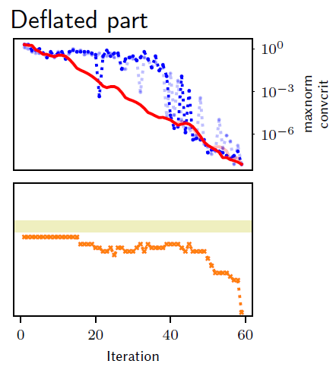
Track kernel accuracy during the development process of QMCkl.
Numerical accuracy: some applications
Harness mixed-precision: 30% speed-up in deflated conjugate gradient (560 cores / YALES2). [3]
First implementation
of Woodbury + Splitting
Accuracy is too low.
Convergence is preserved and…
…the deflated solver runs on single precision.
Simplify intermediate
products. No effect
on accuracy.
Fix numerical bug
(group splits at the end
of update queue).
Git commits (QMCkl – SMWB kernels)
[3] Automatic exploration of reduced floating-point representations in iterative methods. Chatelain et al. Europar’19.

Slide 14
WEBSITES
TREX web site: https://trex-coe.eu
TREXIO: https://github.com/trex-coe/trexio
QMCkl: https://github.com/trex-coe/qmckl
QMCkl documentation: https://trex-coe.github.io/qmckl
MAQAO: http://www.maqao.org
Verificarlo: https://github.com/verificarlo/verificarlo

